Slide 1

Software Process
Chapter 02
Spring 2023

Slide 2
Text and Resources
SEPA– Chapters 2
Agile Methods
https://www.atlassian.com/agile/scrum -
Project Management Tools
Trello
Microsoft TFS
Atlassian JIRA

Slide 3
Key Concepts
Terminology
Software Processes
Waterfall Method
Incremental Methods (Agile)
Scrum
Kanban
Differences between Waterfall and Incremental
Activities
Process Changes

Slide 4
Today Topics
Terminology
Processes

Slide 5
Terminology
Customer – the person(s) whom you are building a software product for. A customer can be external to your organization. A customer can be internal to your organization
Stakeholder – people or groups that are affected by the software process. These can be an end user, customer, or someone just interested in the final product (e.g. manager).

Slide 6
Terminology
User – the person or system that will interact with the software you are creating
User Story – A statement that captures the who, what, why to help drive writing a requirement

Slide 7
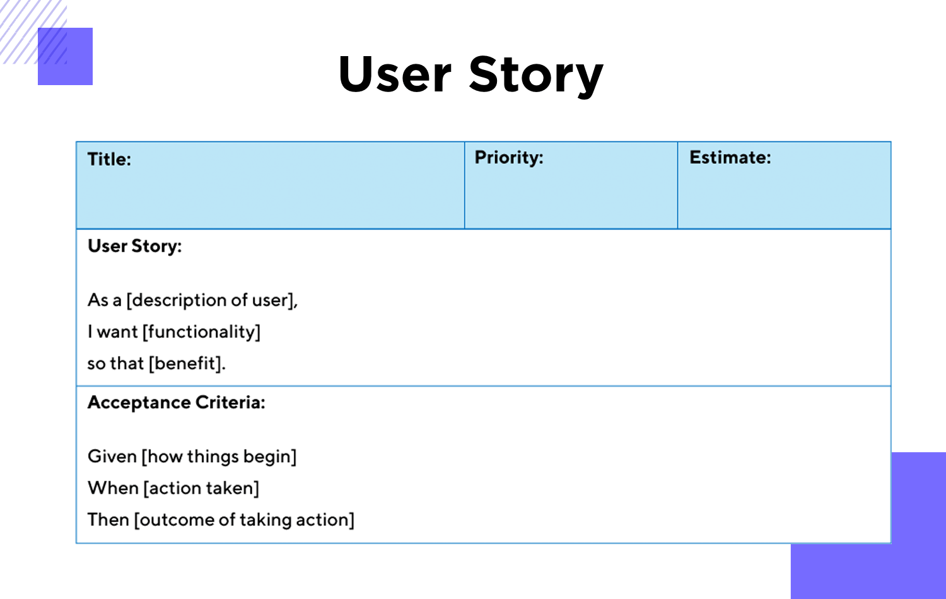
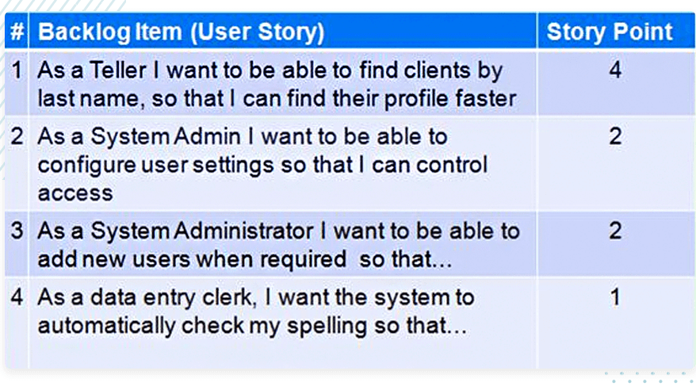
Terminology
User Story – A statement that captures the who, what, why to help drive writing a requirement

Slide 8
Terminology
Software Process – the method a team will use in management of work and other engineering activities to produce software and documentation
Requirement – a statement about how a system should or must function or a quality a system must possess
Specification – a document that specifies a system or product (think of this as a collection of requirements)
Validation – the process of checking whether the specification meets the client’s needs
Verification – the process of checking that the software meets the specification

Slide 9
Terminology –
Activity – actions that a team will perform as part of a software process, e.g. design analysis, requirement writing, implementation
Artifact – something that an engineering team will produce, e.g. a software requirement specification, that is the result of an activity
Design – (noun) artefacts that describes software’s structure (e.g. relationships between objects) and behavior (e.g. sequences, threading models)
Component – a sub-system of software that may have several other
Architecture – an artefact as part of a design that focuses mainly on structural elements, typically at a component level

Slide 10
Terminology –
Task – a piece of work that needs to be completed
Bug – a defect or non-conformity of software, where the product does not match the requirements (not always a crash)
Ticket – a record that documents a task, bug, requirement, to be completed by a development team –
Backlog – a collection of tickets used in incremental development (e.g. agile) approaches, that are not currently being worked on
Prototype – a software artifact that is created to demonstrate proof of concept – and likely used to solicit feedback from a customer

Slide 11
Terminology –
Configuration Management – tasks and tools and structures for software development teams to manage the changes in software
Version Control – tools for controlling changes in software (e.g. rcs, cvs, svn, and git)
Continuous Delivery – software engineering process where teams focus on delivery of software features in short cycles
Continuous Integration – process of merging developer changes constantly as they are completed
Pull Request – mechanisms that allow a developer to merge code changes, and have other team members review those changes to ensure quality

Slide 12
Terminology –
Software Engineering
Defined by IEEE 610.12-1990 as:
The application of a systematic, disciplined, quantifiable approach to the development, operation, and maintenance of software; that is, the application of engineering to software.
The study of approaches in 1.

Slide 13
Software Processes
Process: A Generic View
Defining a Framework Activity

Slide 14
Software Processes
Process: A Generic View
Defining a Framework Activity

Slide 15
A Process Framework
Process framework
Framework activities
work tasks
work products
milestones & deliverables
QA checkpoints
Umbrella Activities

Slide 16
Software Processes
Process Flow

Slide 17
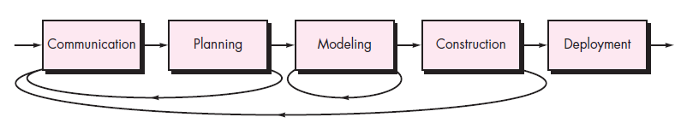
Software Processes
Iterative process flow

Slide 18
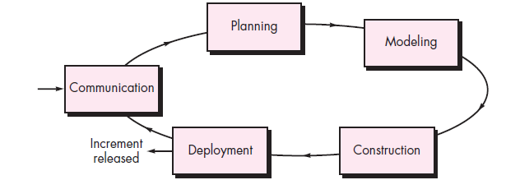
Software Processes
Evolutionary process flow

Slide 19
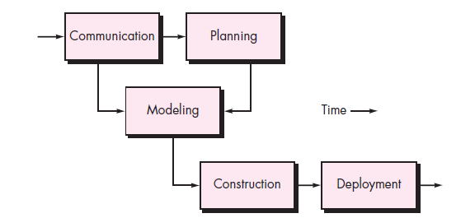
Software Processes
Parallel process flow

Slide 20
Software Processes
Process: A Generic View
Identifying a Task Set

Slide 21
Software Processes
Identifying a Task Set
For a small, relatively simple project, the task set for
requirements gathering might look like this:
Make a list of stakeholders for the project.
Invite all stakeholders to an informal meeting.
Ask each stakeholder to make a list of features and functions required.
Discuss requirements and build a final list.
Prioritize requirements.
Note areas of uncertainty.

Slide 22
Waterfall
Requirements
Series of well defined phases
Requirements
Design
Implementation and Unit Testing
Integration Testing
Deploy
Operation and Maintenance
The next phase does not start until the current phase ends
Design
Implementation
Verification
Maintenance

Slide 23
Waterfall
First published in large military systems engineering (Royce, 1970)
Known as a plan-driven model – you plan all activities before you start software development

Slide 24
Waterfall
Good For
Bad For
Embedded Systems –
(according to Sommerville – I disagree on this one)
Critical Systems
Safety and security
Large Systems
Built by several partnering companies
Projects where software requirements change quickly (most software applications)

Slide 25
Applying this in the real world?
Software development teams typically do not use the waterfall method.
One of the main reasons is that customers change their mind…A LOT
BE ready for someone to ask you to build something, you’ll get half way through, and they will change their mind

Slide 26
Real world? Why do they change their mind?
It’s not their fault. Software is inherently abstract.
People often do not understand what we are capable of.
Sometimes customers have to make assumptions early, and they don’t fit. So customers have to change the requirements.
Don’t take offense

Slide 27
Incremental
Allows the team to have flexibility in the process
Allows different phase activities (e.g. requirements elicitation and implementation) to be concurrent
Agile methods
Scrum
Kanban
Agile is the concept that effort is focused on the deliverable rather than documentation
https://agilemanifesto.org/

Slide 28
Agile – What is it?
E
Customer satisfaction
Early and continuous delivery
Embrace change
Frequent delivery
Collaboration of businesses and developers
Motivated individuals
Face-to-face conversation
Functional products
Technical excellence
Simplicity
Self-organized teams
Regulation, reflection and adjustment

Slide 29
Agile Manifesto
E
We are uncovering better ways of developing software by doing it and helping others do it. Through this work we have come to value:
Individuals and interactions over processes and tools Working software over comprehensive documentation Customer collaboration over contract negotiation Responding to change over following a plan
That is, while there is value in the items on the right, we value the items on the left more.

Slide 30
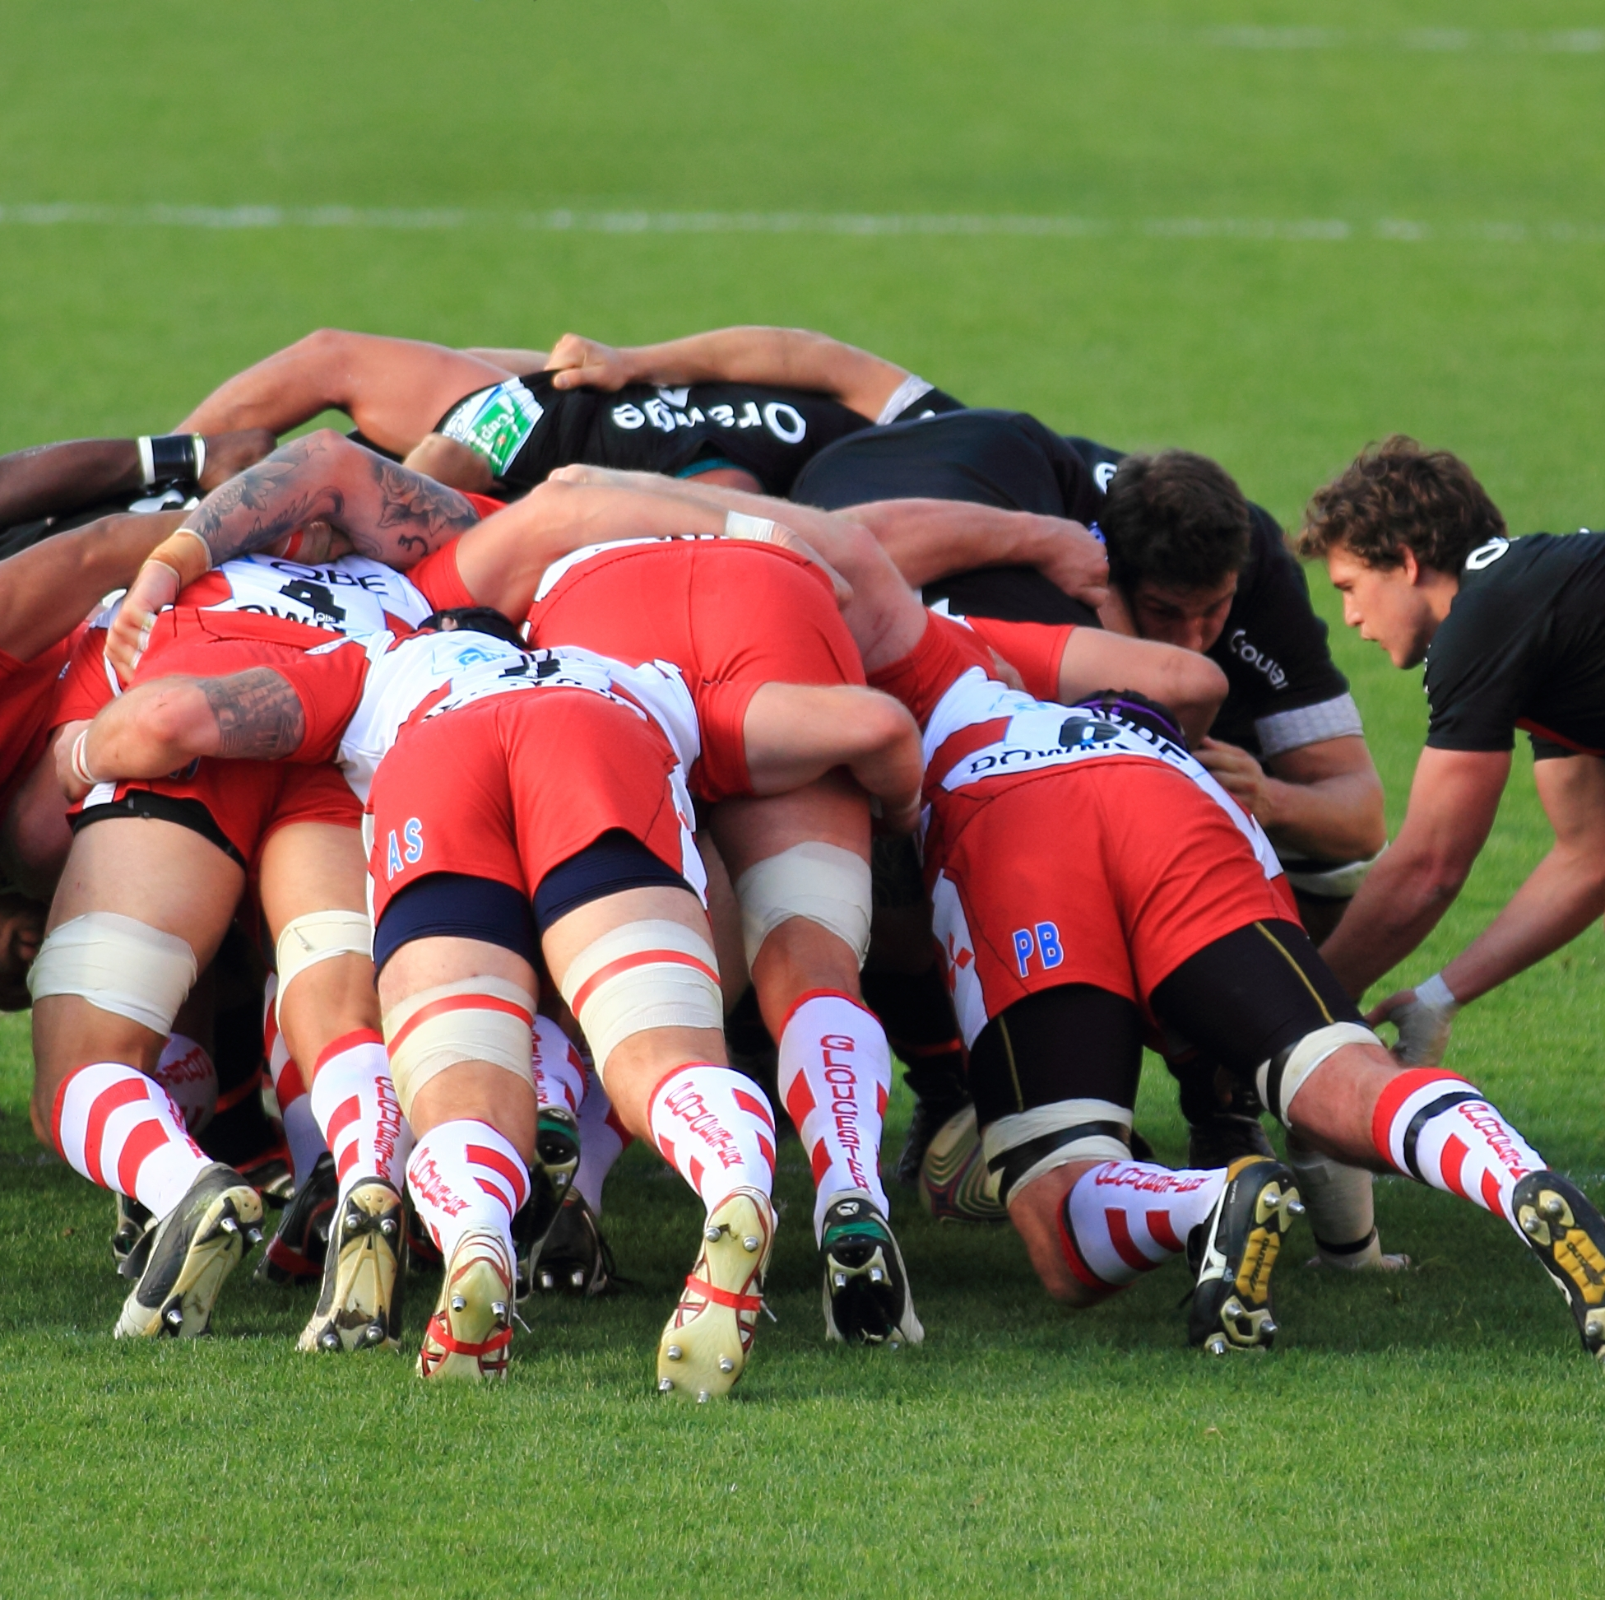
Scrum – The What
E
An agile process model
Scrum – comes from the sport - Rugby
Incremental development
Timeboxing
Break up your efforts into 2-3 week developments called sprints
Fit as many activities as you can into this time window

Slide 31
Scrum – The Who
E
Product Owner – stakeholder – holds the vision for the product – often works with the client
Scrum Master – person who keeps the team on pace, works with product owner to develop scope, and ensure tasks are being completed
Development Team – implements code, works with scrum master to identify risks, bottlenecks, etc.

Slide 32
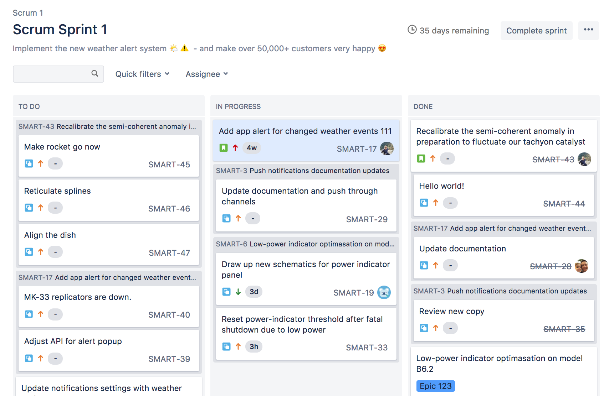
Scrum – Sprint Board / Backlogs
E
Sprint board – an electronic board that displays tickets in swim lanes where each column is the state of a particular ticket
Backlog – a collection of tickets presented on a board often which are organized based on priority. The topmost items are often the items that are highest priority

Slide 33
Admin
5 minutes – Zoom Setup and Admin Update - Schedule
5 minutes – Assignment 1 Questions
70 minutes – wrap up process lecture

Slide 34
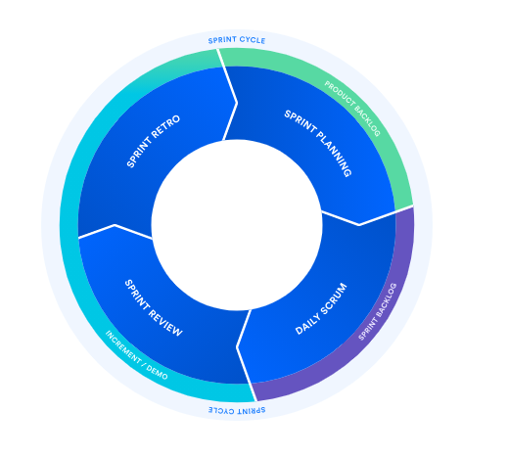
Scrum – The Process
E
Planning
Backlog grooming
Integration of new or planned tasks
Daily Scrum
Updates / meetings that are performed - standups
Review
Demos, discussion about how things were integrated
Retrospective
Discussions about how to fix the process
WSU-TC CptS 322-Spring 2021

Slide 35
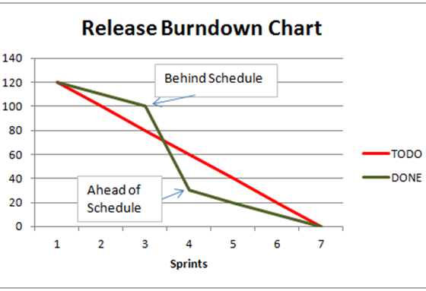
Scrum – Time and Changes
E
One key thing about Scrum – once a sprint starts, the team must carry out that sprint - there is no room for adjusting the sprint
Time is measured in “story points”
1, 2, 4, 8, 16
Velocity – metric for measuring how fast things are moving

Slide 36
Kanban – The What
E
Another agile / incremental approach
No-timeboxing – focused on continuous delivery
Toyota – 1940’s – just in time manufacturing
Lean manufacturing
More amenable towards web-development where deployment of software is much easier, e.g. when compared to desktop apps

Slide 37
Kanban – Who / How / Timing
E
Kanban Board
Requested
In-Progress
Done
Kanban does not have required roles
Kanban measures progress using three metrics vs. velocity

Slide 38
Kanban – Time Metrics
Metric | Definition | Why?
Lead Time | time between customer request to delivery | Is the customer waiting a long time?
Cycle Time | amount of time it takes to go from work started to work delivered | How long is taking us to get this out?
WIP | number of task items that a team is currently working on | Are we overworking our team?
Metric | Definition | Why?
Velocity (Scrum) | The number of story points being accomplished per unit time | How fast are we moving?

Slide 39
Incremental
Good For
Bad For
Projects with changing requirements
Projects where the client is unsure what they need
Customer needs a small aspect of the software
Unmotivated teams
Large organizations that may have their own policies that conflict with the more “informal” agile methods
“Process” not visible to managers because activities can be concurrent
System structure can degrade over time

Slide 40
Differences?
Waterfall
Incremental
Favors documentation and complete analyses of requirements and design
Product delivered at the end of the whole process
Reduction of costs for changing requirements because documentation and analyses are typically fluid
Product can be delivered in stages

Slide 41
Waterfall
Incremental
Requirements
Requirements
Design
Design
Implementation
Implementation
Verification
Verification
Maintenance
Maintenance
At any phase of the approach – requirements analysis and specification may be revisited

Slide 42
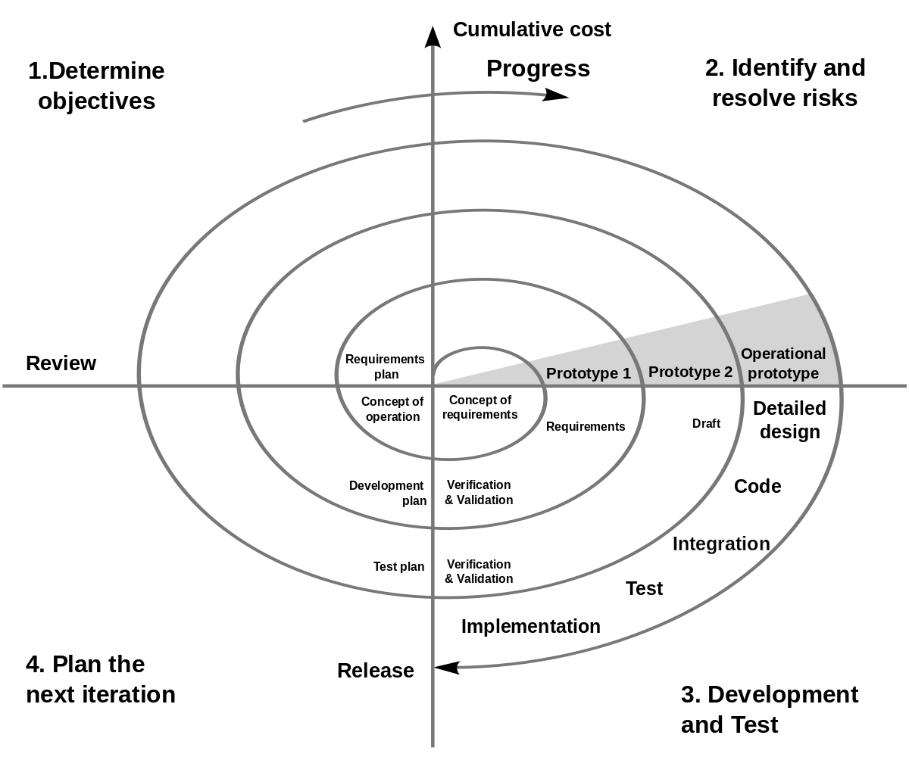
Incremental
The spiral model is one of the best ways to understand how incremental models work
Determine Objectives
Identify Resol

Slide 43

This Class?
We are going to use the Waterfall Process
Why?
3 months (15 weeks)
Competing priorities (classes)
Learning – going through the simplest process first gets your feet wet (no pun intended)
Most of what you will all do

Slide 44
Process Activities

Slide 45
Software Specification
Process of understanding the system
What are the constraints?
What systems already exist?
Often times company’s / teams will perform market research, feasibility studies
What we want at the end of the day – “a document” – software requirements specification (SRS) – that captures the stakeholder / clients requirements.

Slide 46
Software Specification Activities
Requirements Elicitation and Analysis – process of deriving the system requirements
Observation of existing systems
Discussion with users, customers, existing systems
Requirements Specification – activity of translating requirements into a document
Requirements Validation – Activity to check that the requirements are real, consistence, and complete
Completed internally
Work with customers to perform activity

Slide 47
Project
You’ll be given a project description
You’ll have a few class periods to come and ask questions – elicit requirements
You’ll have some time to write these requirements
You’ll have some class periods to validate your specification

Slide 48
Software Design and Implementation
Process of building the executable
Translation of requirements into design and then implementation
Design – description of the software
Behavior – flow of data, sequences of events
Structure – relationships between components
Implementation – “coding”

Slide 49
Software Design and Implementation
Design and implementation can happen concurrently
Mostly in agile models
Design then implementation
Waterfall
Main Activities
Architectural Design – overall structure – layout of principle components
Database Design – structure of data, relationships, etc.
Interface Design – interfaces between components
Component Selection and Design – identification of reusable components

Slide 50
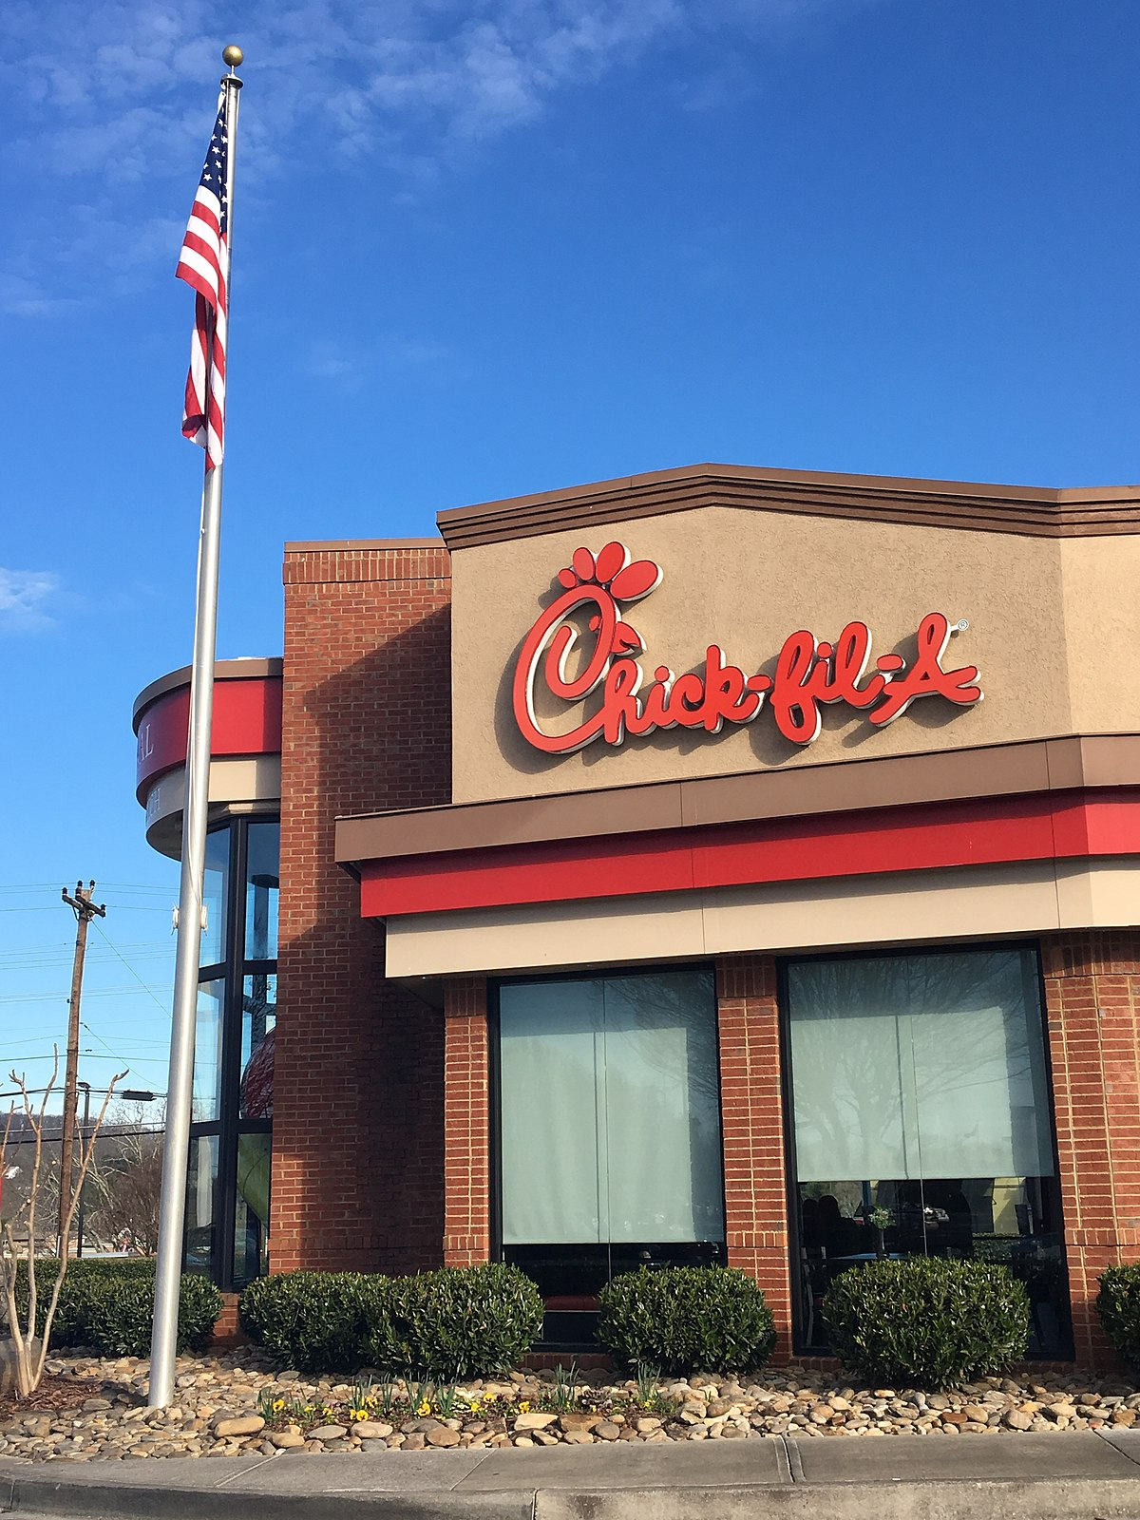
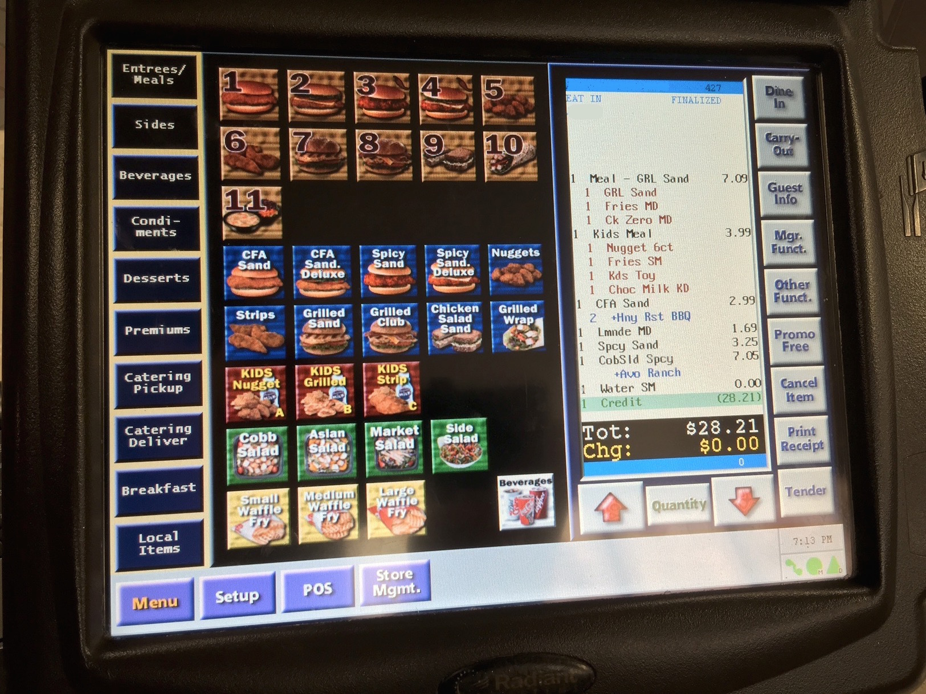

Slide 51

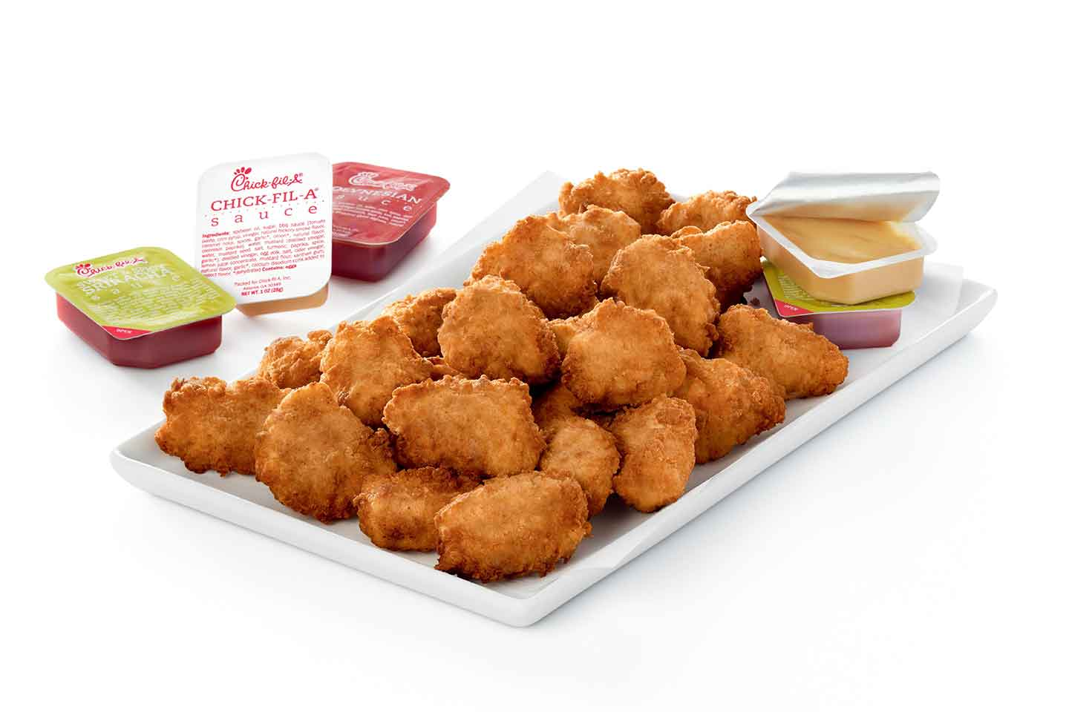
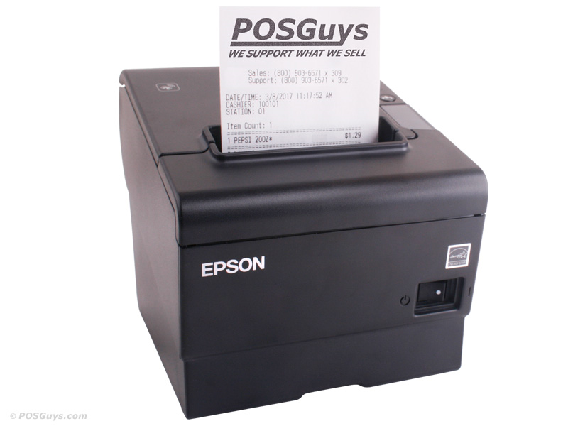
User Management
Order Entry
Database
Inventory Management
Printer

Slide 52
User Management
Order Entry
Database
Inventory Management
Printer

Slide 53
User Management
What are the interfaces?
How is the data stored?
Order Entry
Database
Inventory Management
What are the exports?
Printer

Slide 54
Software Validation
V&V – Validation and Verification
Validation – Are the requirements correct?
Verification – Did we build it correctly?

Slide 55
Software V&V
Component Testing – early stages of implementation
System Testing – later stages of implementation
Customer Testing – before delivery / as part of delivery

Slide 56
Software V&V – Component Testing
Focuses on individual components
Unit Testing – a method of verifying that individual classes, components function as required
Use of simulated data often part of this testing process
Answers Questions
Does the printer code work correctly?
Does our order system add correctly?

Slide 57
Software V&V – System Testing
Focuses on integration of components
Do your interfaces work correctly?
Also uses simulated data
Answers Questions
When an order is submitted, does the inventory amounts update correctly?

Slide 58
Software V&V – Customer Testing
Beta testing
Does the customer find any issues?
Does the customer accept the product?
Answers Questions
Does the system meet the customers needs?

Slide 59
System V&V - Concepts
In waterfall – you are going to implement the project, and perform testing as the last stage before release. When you get to customer testing you are basically delivering the product
In incremental – you may deliver a product (beta) version to the user for verification – and the product may not be complete. You may use customer interaction to gain further feedback and help refine requirements or generate new ones.

Slide 60
Software V&V - Tooling
You’ll later learn about different tools for testing (this course and others)
Some Key Tools
Track Your Work - Bug Tracking System (e.g. Trello, JIRA) to help track defects / bugs
Write Software Tests - Testing Frameworks for Component and System Testing (e.g. NUnit, JUnit, MSTest)
Track Manual Tests Testing Plug-ins (e.g. Zephyr) for managing and tracking test data

Slide 61
Software V&V - Traceability
6-month Principle
6-months from now you’re going to look at code and go…What The Fudge? (WTF)
One of the hardest things to maintain are tests.
Component Tests (e.g. whitebox) that are not properly documented
Unit tests WILL break – and that’s a good thing
What are they? Why are they important?

Slide 62
Software V&V - Traceability
Requirement
Test
What needs to built
How we verify that
Traceability is one of the most key aspects in software engineering

Slide 63
Software V&V - Traceability
Test Output v1.0
Requirement
Test
Test Output v1.1
Test Output v1.2
What needs to built
How we verify that
Good teams will also track test data per version (inputs and outputs)

Slide 64
Software Evolution
Software changes
Requirements change
Tests will have to change
Systems become more and more complex
Versioning and Tracking IS IMPORTANT

Slide 65
Versioning
There are different ways to version your software –
Major.Minor.Patch (https://semver.org/)
Major.Minor.Build
Major.Minor.Revision
Date
Honestly, there is no right way – what is important is to capture differences in the software
Versions really only mean something to the development team

Slide 66
Versioning
Major.Minor.Patch
MAJOR version when you make incompatible API changes,
MINOR version when you add functionality in a backwards compatible manner
PATCH version when you make backwards compatible bug fixes.
https://semver.org/

Slide 67
How does versioning relate to process?
Dev
System Testing
Customer Testing
1.0.0
1.0.0
1.0.0
Your software verification phase may have multiple stages
It’s important to track the candidates for releases – so that defects can be properly tracked and verified.
1.0.1
1.0.2
1.0.2
1.0.3
1.0.3
1.0.3

Slide 68
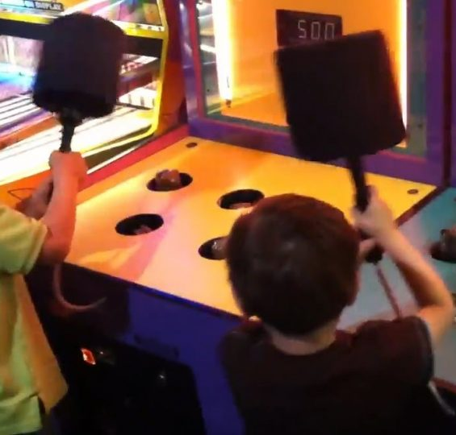
Testing and Release
We typically have concurrent dev, test, and release/acceptance activities occurring
It’s really important to communicate and stay organized

Slide 69
Coping with Change
Change is inevitable – and staying organized is key
Approach software development KNOWING and ACCEPTING that requirements will change based on
Business needs
Competition
Priorities

Slide 70
Prototyping
System Prototyping – a way to handle expected or anticipated changes
Focuses on small parts of a system – how might it look? Is this feasible? Show a customer and get their feedback
Incremental Delivery - Delivering prototypes to customer (CD)
Amazon, Google, etc. will actually test features on you. You may see a different site than your friends and may not even know it.

Slide 71
Prototyping – wait what is it?
Early version of software or feature that is used to demonstrate proof of concepts.
Good way to get something in front of a user (stakeholder more often than not) so they can provide feedback – you can collect useability data
Used to help control costs – sometimes some of the key steps in the engineering process are minimized (e.g. design)

Slide 72
Prototyping – the pitfall
Sometimes prototypes are just adopted as the end product. The customer likes the prototype and it may be accepted as useable
The concept of a throwaway prototype is not enacted
The design, however, may not be extensible (i.e. easy to modify)
When you develop a prototype attempt to still develop as though you are writing an end product

Slide 73
Process Improvements
Process improvement is the act of trying to reduce costs and deliver quicker
Sommerville describes two
Process Maturity – focuses on improving process and project management
Agile – focuses on iterative development and reduction of overheads

Slide 74
Process Maturity
Process Measurement
Establish attributes to measure how well you are maintain cost and schedule
Process Analysis
Identification of weaknesses and bottlenecks
Process Change
Propose changes to the process to fix identified weaknesses

Slide 75
Capability Maturity Models
Initial - CMM1
goals associated to process area are satisfied and communicated to the team
Managed - CMM2
goals are associated with process area, organized policies are in place that define when each process should be used
Defined – CMM3
Organizational standardization and deployment of processes
Process assets and measurements are collected and used to make improvements qualitatively

Slide 76
Capability Maturity Models
Quantitatively Managed - CMM4
Statistical methods are used to control sub-processes – used in process management
Compared to Defined – (CMM 3) processes are quantitatively vs. qualitatively predictable.
Optimizing – CMM5
Use process and product measurements to drive process improvements. Trends are established an analyzed to adapt to changing business needs
Focuses on shifting the trend in performance – vs. – fixing just special cases identified (CMM4)

Slide 77
Experience…
No one software process works for all projects
No one software process works for all teams
Software processes should be allowed to evolve
New clients
New requirements
Competition
Software processes should be reviewed regularly
DEFINE your process – communicate – and get buy in!

Slide 78
Experience…
Software processes are intended to keep teams organized and coordinate activities across teams or people
Tooling has come a long way – use electronic tools where you can
Establish patterns to create repeatable work – use best practices, workflows, that are established within industry
DON’T CREATE YOUR OWN! Not right now anyway

Slide 79
Communicate, Communicate, Communicate

Slide 80
Questions?

